Slide 1
Deepfake Detection
Using CNNs
Training a PyTorch image classification model to identify real vs. manipulated face videos
PyTorch
Computer Vision
CNNs
Ben Wayland, Chloe Just, Luke Lu
DATA 621 Final Project

Slide 2
Why We Chose This Project
The topic connects deep learning to a real-world problem in media trust and digital security.
Real-world relevance
Strong fit for CNNs
End-to-end workflow
Deepfakes can be used to spread misinformation, impersonate public figures, or manipulate digital media.
The task is visual: CNNs can learn patterns and artifacts from cropped face images.
The project includes data processing, PyTorch DataLoaders, model training, and evaluation.
Goal: classify cropped face images as real or fake.
The project demonstrates both data preparation and model development.
The model could eventually support video-level deepfake detection.
DATA 621 Final Project | 2

Slide 3
Background: What Is Deepfake Detection?
Deepfake detection attempts to identify whether media has been synthetically manipulated.
Deepfakes are manipulated videos or images that imitate real people.
Visual clues can be subtle, especially around facial features, lighting, texture, and motion.
CNNs are useful because they learn spatial patterns directly from image pixels.
This project focuses on face crops because the face region contains the most relevant evidence.
Classification Task
Input
224×224 face image
Output
Fake or Real
The model learns the difference between authentic and manipulated face images through supervised training.
DATA 621 Final Project | 3

Slide 4
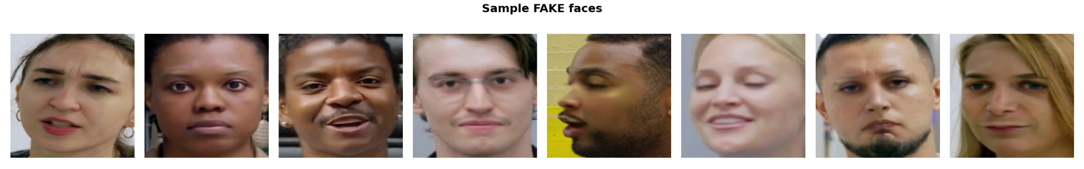
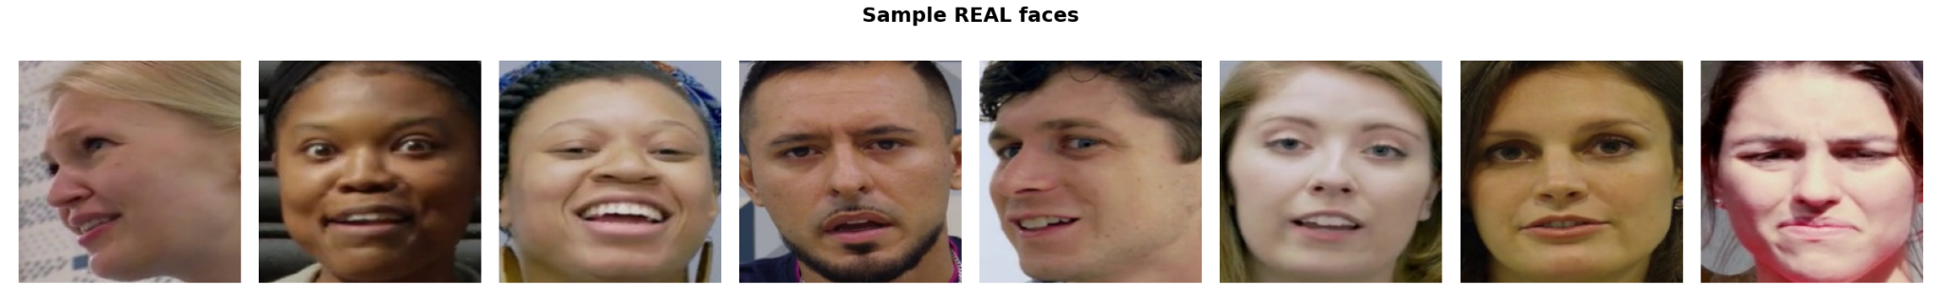
Data Used and Data Description
FaceForensics DFD dataset: raw videos converted into labeled face images.
Raw data
Video format
Final images
Splits
363 real videos
3,068 fake videos
3,431 total videos
Short .mp4 clips
Sample FPS: 24
Resolution: 1920×1080
82,052 cropped faces
224×224 pixels
Fake = 0, Real = 1
Train: 70%
Validation: 15%
Test: 15%
DATA 621 Final Project | 4

Slide 5
Data Pipeline and Preprocessing
The project converts video data into model-ready PyTorch image batches.
Raw Videos
Frame Extraction
Face Cropping
Split Dataset
DataLoaders
Original and manipulated .mp4 files
About 1 frame per second
MTCNN detects and crops faces
Train / val / test = 70 / 15 / 15
Batches ready for PyTorch
Training transforms: resize/crop, augmentation, normalization using ImageNet mean and standard deviation.
Validation/test transforms: resize and normalization only, so evaluation is consistent.
DataLoader verification: sample batch shape = [32, 3, 224, 224].
Key result: the data pipeline is complete, verified, and ready for CNN training.
DATA 621 Final Project | 5

Slide 6
Model Used: CNN Transfer Learning
Recommended baseline: pretrained ResNet-18 with a new final layer for binary classification.
Input: 224×224 RGB face image.
Feature extractor: pretrained convolutional layers from ResNet-18.
Classifier head: replace the original ImageNet layer with a 2-class output layer.
Output: predicted class probabilities for fake vs. real.
Input
CNN Blocks
Output
3×224×224
ResNet features
Fake / Real
Why Transfer Learning?
Using a pretrained model helps when training time is limited. The earlier layers already recognize general visual features like edges, textures, and shapes. The final layer is then adapted to our deepfake detection task.
DATA 621 Final Project | 6

Slide 7
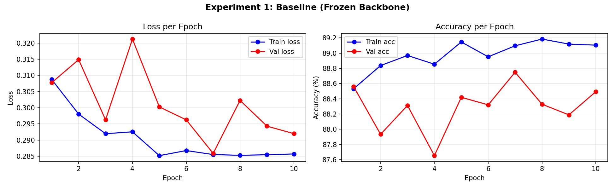
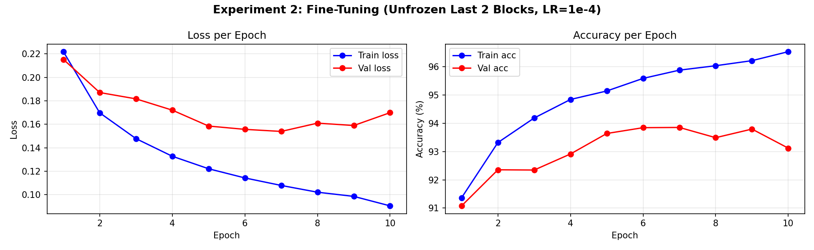
Loss Function and Hyperparameters
Two-phase transfer learning: frozen baseline then fine-tuned backbone
Loss Function
Optimizer
Regularization
LR Scheduler
CrossEntropyLoss
Standard for classification
Combines log-softmax + NLL
Adam
Adapts LR per-parameter
weight_decay = 1e-4 (L2 reg)
Dropout p = 0.3
L2 weight decay = 1e-4
Prevents overfitting on head
ReduceLROnPlateau
factor = 0.5, patience = 2
Halves LR when val acc stalls
Experiment 1 — Frozen Baseline
Experiment 2 — Fine-Tuning (Winner)
Epochs: 10 | LR: 1e-3
Frozen backbone (head only)
Trainable params: 2,562
Best val accuracy: 88.75%
Final train loss: 0.2857
Epochs: 10 | LR: 1e-4
Unfroze last 2 backbone blocks
Trainable params: 1,131,954
Started from Exp 1 best weights
Best val accuracy: 93.86% ← Winner
Final train loss: 0.0905
DATA 621 Final Project | 7

Slide 8
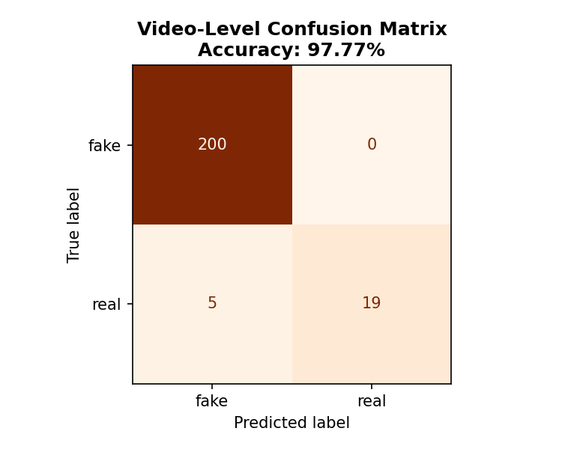
Video-Level Prediction
Aggregating per-frame predictions into a single verdict for each video
1
2
3
4
Video split into frames
Model predicts each frame
Majority vote per video
Final video verdict
Each video produces ~30 face
images during preprocessing.
EfficientNet-B0 outputs 'fake'
or 'real' for every frame.
Count fake vs. real predictions.
Majority class wins.
If fake frames > real frames,
the video is labelled FAKE.
DATA 621 Final Project | 8

Slide 9
Results
EfficientNet-B0 fine-tuned on 82,052 face images from the DFD dataset
93.27%
97.77%
0.9573
Frame-level accuracy (12,410 test frames)
Video-level accuracy (224 test videos, majority vote)
AUC score (1.0 = perfect, 0.5 = random)
Frame-Level Classification Report
Video-Level Results
FAKE — Precision: 96% | Recall: 96% | F1: 96%
REAL — Precision: 72% | Recall: 73% | F1: 72%
Lower real-class scores reflect class imbalance:
10,902 fake frames vs. 1,508 real frames in test set.
FAKE — Precision 98% | Recall 100% | F1 99% | Support: 200 videos
REAL — Precision 100% | Recall 79% | F1 88% | Support: 24 videos
Lower real-class scores reflect class imbalance:
200 fake videos vs. 24 real videos in test set.
DATA 621 Final Project | 9

Slide 10
Challenges and Limitations
The biggest barriers are data size, compute limits, and class imbalance.
Large storage needs
Runtime limits
Class imbalance
Video data and extracted frames exceeded the limits of a normal free cloud workflow.
Frame extraction and face detection took hours and depended on GPU availability.
The processed dataset contains far more fake images than real images.
DATA 621 Final Project | 10

Slide 11
Future Work and Conclusion
What we would explore next, and what this project demonstrated.
If We Had More Time...
Key Takeaways
Classify deepfake methods — identify FaceSwap, Face2Face, and NeuralTextures as separate classes.
Try larger models — EfficientNet-B4 or ConvNeXt for +2–5% accuracy gains.
Use video clips — CNN + LSTM to catch temporal inconsistencies (blinking, lip sync).
A complete end-to-end pipeline was built from raw videos to trained CNN.
EfficientNet-B0 with transfer learning reached 93.27% frame accuracy.
Video-level majority voting pushed accuracy to 97.77% on 224 test videos.
The project demonstrates that CNNs can effectively detect deepfakes without audio or metadata.
AUC of 0.9573 confirms the model produces reliable confidence scores.
DATA 621 Final Project | 11

Slide 12
Reference List
Paszke, A., Gross, S., Massa, F., Lerer, A., Bradbury, J., Chanan, G., Killeen, T., Lin, Z., Gimelshein, N., Antiga, L., Desmaison, A., Köpf, A., Yang, E., DeVito, Z., Raison, M., Tejani, A., Chilamkurthy, S., Steiner, B., Fang, L., Bai, J., . . . Chintala, S. (2019). PyTorch: An imperative style, high-performance deep learning library. Advances in Neural Information Processing Systems, 32, 8024–8035. https://arxiv.org/abs/1912.01703
Rössler, A., Cozzolino, D., Verdoliva, L., Riess, C., Thies, J., & Nießner, M. (2019). FaceForensics++: Learning to detect manipulated facial images. Proceedings of the IEEE/CVF International Conference on Computer Vision (ICCV), 1–11. https://arxiv.org/abs/1901.08971
Selvaraju, R. R., Cogswell, M., Das, A., Vedantam, R., Parikh, D., & Batra, D. (2017). Grad-CAM: Visual explanations from deep networks via gradient-based localization. Proceedings of the IEEE International Conference on Computer Vision (ICCV), 618–626. https://doi.org/10.1109/ICCV.2017.74
Tan, M., & Le, Q. V. (2019). EfficientNet: Rethinking model scaling for convolutional neural networks. Proceedings of the 36th International Conference on Machine Learning (ICML), 6105–6114. https://arxiv.org/abs/1905.11946
Tiwarekar, S. (2023). Deep Fake Detection (DFD) entire original dataset [Data set]. Kaggle. https://www.kaggle.com/datasets/sanikatiwarekar/deep-fake-detection-dfd-entire-original-dataset
Zhang, K., Zhang, Z., Li, Z., & Qiao, Y. (2016). Joint face detection and alignment using multitask cascaded convolutional networks. IEEE Signal Processing Letters, 23(10), 1499–1503. https://doi.org/10.1109/LSP.2016.2603342
DATA 621 Final Project | 12

